Slide 1
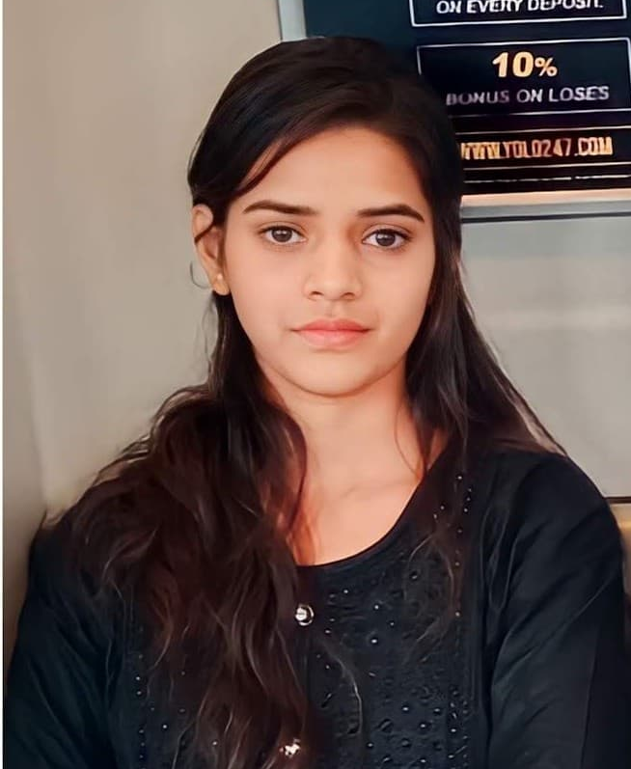

Project Title
SuperStore_Data_Analysis
[Student Details]
Name:- Neha Kumari
Father’s Name:- Vidyalal Mahto
Mobile:- +91 9263691287
E-mail:- nehakumari143mjh@gmail.com
University:- Jagannath University jaipur
Internship At:- Connecting Dreams Foundation
Internship Domain:- Data Analytics with AI-LLMS
AICTE ID:- STU66d5e871a96921725294705
Note:- I have not received my Internship offer letter, so I’ve not apply id and internship id

Slide 2

PROBLEM STATEMENT
The data is very challenging and facing to
problems to load data.
As a beginner, I was faced too many problems
during to analysis the data.
Lack of Data-Driven and Decision-Making
culture problems.

Slide 3
Project Description
This project involves analyzing sales data from a "Super Store" to gain insights into various aspects of its operations. The dataset includes various information like this:- on shipping modes, customer segments, geographical locations, product categories, sales, discounts, and profits. Key areas of analysis may include identifying trends in sales performance, understanding profitability by region or product category, and examining the impact of discounts on profits. The goal is to provide a comprehensive overview of the store's operations to support decision-making and improve business strategies.

Slide 4

WHO ARE THE END USERS?
The students who wants to learn more about Data Analysis using AI-LLMS.
This project, it will be helpful for them.
In this project, clearly described about graphs and other functionality.

Slide 5

Technology Used
Programming Language:-Python
IDE:- Visual Studio Code
Environments:- Jupiter Notebook/Google Colab (any one)

Slide 6
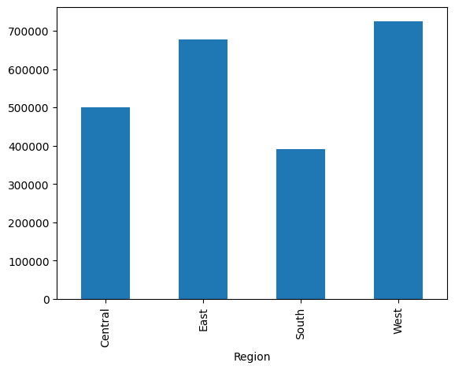
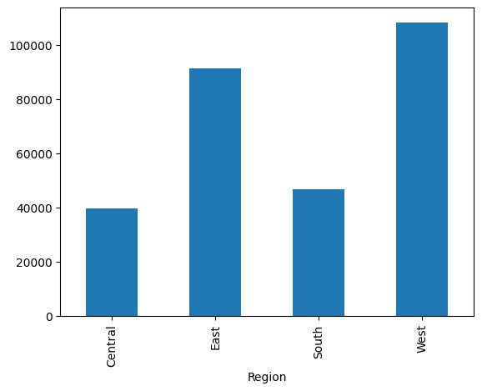
RESULTS
Sales
Profit
Both of this Bar graphs are shows Region wise Sales and Profit
Demo Link

Slide 7
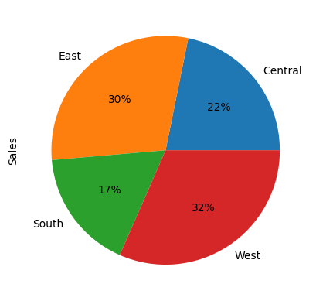
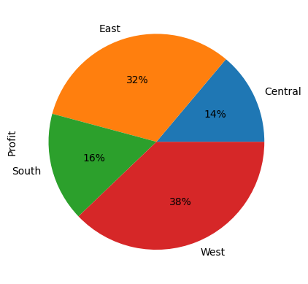
Sales
Profit
Both of this Pie graphs are shows Region wise how much Sales and Profit in (%age)

Slide 8
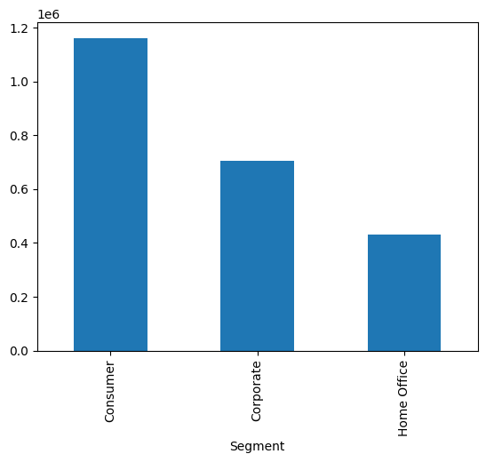
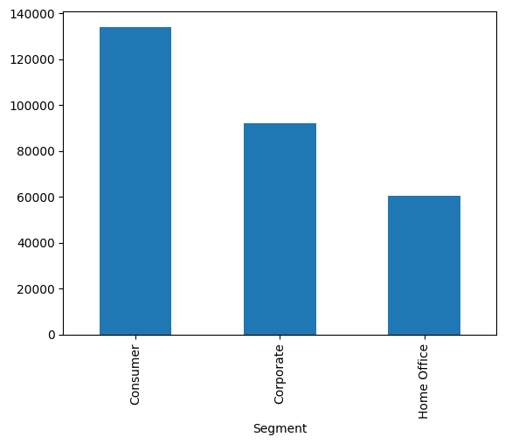
Sales
Profit
Both of this Bar graphs are shows Segment wise Sales and Profit

Slide 9
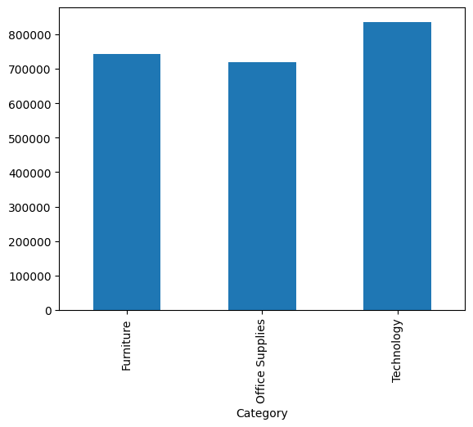
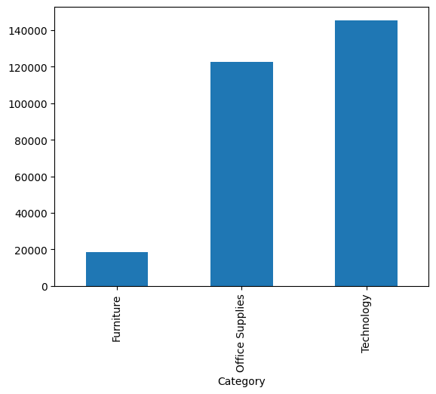
Sales
Profit
Both of this Bar graphs are shows Category wise Sales and Profit

Slide 10
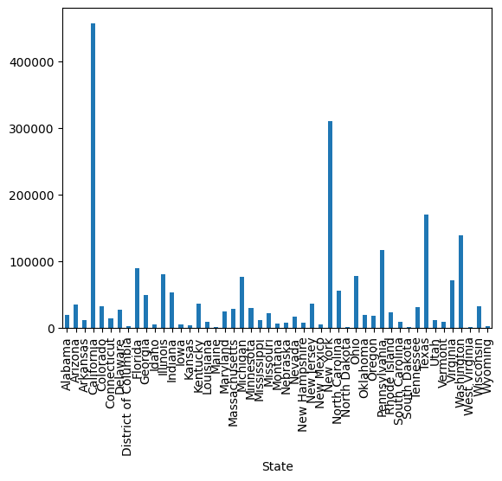
This Bar graphs are shows State wise Sales.

Slide 11
More Information
GitHub Repository Link:-
https://github.com/Neha926369/Superstore-DA.git
LinkedIn:- https://www.linkedin.com/in/neha-kumari-965a51334?

Slide 12
Thank You
.
.

